Slide 1


Machine Learning 2 Project
Adam Janczyszyn
Hubert Wojewoda

Slide 2

DATASETS
CHOSEN
German Credit Risk
Red Wine Quality
Classification
Regression
The original dataset contains 2000 entries with 20 categorial/numerical attributes prepared by Prof. Hofmann. In this dataset, each entry represents a person who takes a credit in a bank. Each person is classified as good or bad credit risks according to the set of attributes.
This datasets is related to red variants of the Portuguese "Vinho Verde" wine. For more details, consult the reference [Cortez et al., 2009]. Due to privacy and logistic issues, only physicochemical (inputs) and sensory (the output) variables are available (e.g. there is no data about grape types, wine brand, wine selling price, etc.).

Slide 3

REGRESSION

Slide 4

VARIABLES
Fixed Acidity: Measures tartaric acid levels, affecting wine's taste and color.
Volatile Acidity: Indicates acetic acid amount; high levels can lead to a vinegar taste.
Citric Acid: Added for flavor enhancement and color stability.
Residual Sugar: Determines sweetness; remaining sugar post-fermentation.
Chlorides: Measures salt content in the wine.
Free Sulfur Dioxide: Prevents oxidation and microbial growth.
Total Sulfur Dioxide: Sum of bound and free SO2; affects smell and taste.
Density: Related to alcohol and sugar content, close to water density.
pH: Measures wine's acidity; most wines are between 3-4 on the pH scale.
Sulphates: Additives contributing to antimicrobial and antioxidant properties.
Alcohol: Percentage of alcohol by volume, influencing taste and body.
Quality (TARGET): Sensory score from 0 to 10 by wine experts, indicating overall wine quality.
+ 10 features added artificially

Slide 5

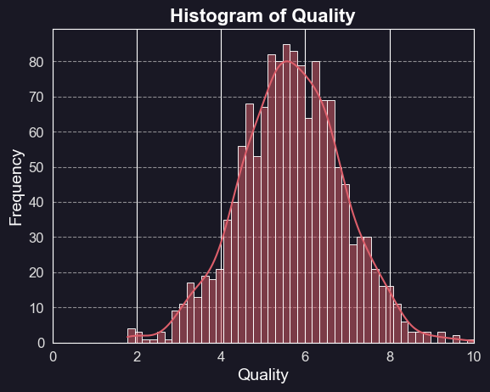
DATA EXPLORATION
1400 observations, 22 features + target
Target stats (Quality) - Max: 10.55, Min: 1.78, Mean: 5.67
All variables are floats, no categorical variables
No missing values in the data
No duplicated values in the data
Many features strongly correlated with target (alcohol, volatile acidity, sulphates, etc.)
Most variables have distributions that resemble normal distribution

Slide 6

DATA PREPARATION
All variables from the intial dataset scaled using StandardScaler
All artificial variables scaled using MinMaxScaler
Used train_test_split, where test is 20% of the data
Scalers fitted on train split, then transformed both train and test
All results checked with k-fold Cross-Validation
StandardScaler
MinMaxScaler
Standardizes features by removing the mean and scaling to unit variance. This is achieved by subtracting the mean value from each feature and then dividing by the standard deviation. As a result, the feature will have a mean of 0 and a standard deviation of 1.
Transforms features by scaling each feature to a given range, typically between 0 and 1. It does this by subtracting the minimum value of the feature and then dividing by the range. This scaling preserves the shape of the original distribution without distorting differences in the ranges of values.

Slide 7
MODELLING APPROACH
We checked a variety of different algorithms and chosen the most promising ones
Linear Regression
Random Forest Regressor
CatBoost Regressor
Offers a straightforward and transparent model that is easy to interpret, making it an excellent choice for understanding the relationship between features and the target. It’s the go-to method for establishing a baseline in predictive performance.
Excels in handling complex datasets with interrelated features. Its ensemble approach, which builds multiple decision trees and merges their outcomes, is effective in reducing overfitting and providing a more generalizable model.
Has strong robustness to different data distributions. It employs gradient boosting on decision trees and has been engineered to deliver state-of-the-art results with minimal hyperparameter tuning. It is one of the spiritual successors to Random Forest.
LightGBM
Stacking
Voting
High performance gradient boosting framework renowned for its speed and efficiency, particularly with large datasets. It uses advanced techniques to accelerate training and reduce memory usage without compromising accuracy.
Ensemble technique that combines multiple regression models to capitalize on their individual predictive power. By learning how to use the strengths of each base model, stacking often achieves better performance than any single model could on its own.
Incorporates predictions from various models and uses a majority vote for the final prediction. This method is beneficial because it can smooth out individual model anomalies and biases, leading to improved accuracy and reliability in predictive outcomes.

Slide 8

MODELLING RESULTS
For each model, we searched for the best hyperparameters (Random Search)
and used Forward Selection algorithm with Random Forest to get the final features
LightGBM
Random Forest
CatBoost
Hyperparameters
'subsample': 0.8,
'reg_lambda': 0,
'reg_alpha': 0.1,
'learning_rate': 0.021,
'colsample_bytree': 0.8
Results
MAPE: 0.17
MAE: 0.87
R2: 0.20
Hyperparameters
'min_weight_fraction_leaf': 0.0,
'min_samples_split': 2,
'min_samples_leaf': 8,
'max_features': 'auto',
'max_depth': 30
Results
MAPE: 0.17
MAE: 0.88
R2: 0.20
Hyperparameters
'learning_rate': 0.046,
'l2_leaf_reg': 0.1,
'iterations':100,
'depth': 6,
'border_count': 254
Results
MAPE: 0.17
MAE: 0.88
R2: 0.20
Linear Regression
Stacking
Voting
Results
MAPE: 0.17
MAE: 0.87
R2: 0.21
Results
MAPE: 0.17
MAE: 0.86
R2: 0.22
Results
MAPE: 0.17
MAE: 0.86
R2: 0.22

Slide 9

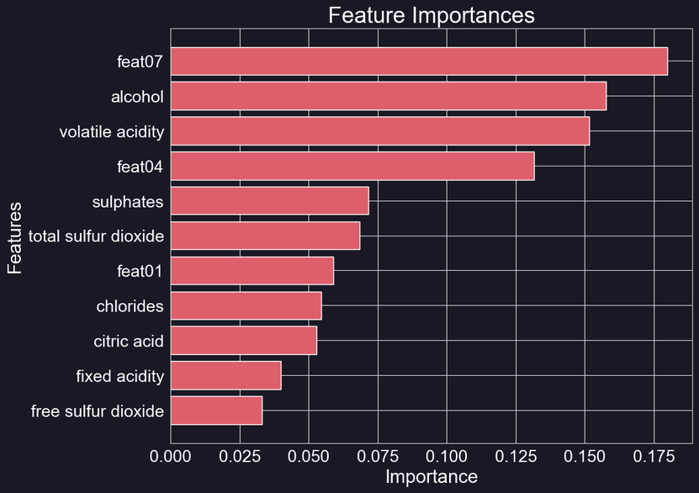
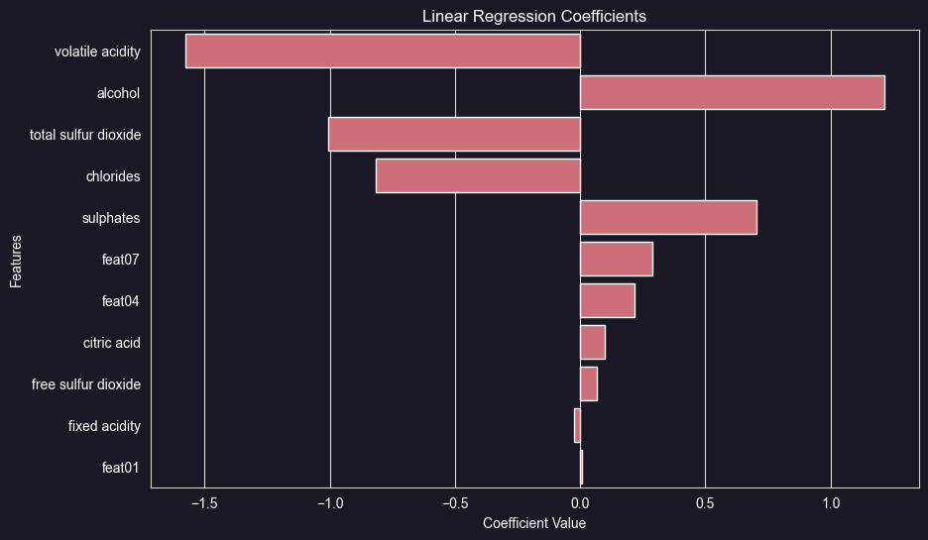
EXPLAINABLE AI
To understand the models a bit better, we can analyze the importance for RF
and directly interpret and check the coefficients of the linear regression model

Slide 10

CLASSIFICATION

Slide 11
VARIABLES
Age: Age of the individual.
Checking Status: Describes the status of the existing checking account.
Credit Amount: The amount of credit requested.
Credit History: Reflects the credit repayment history.
Purpose: Specifies the reason for seeking credit.
Savings Status: Indicates the status of savings accounts or bonds.
Employment: Duration of present employment.
Installment Rate: The percentage of disposable income dedicated to installments.
Personal Status and Sex: Combines information about personal status and gender.
Other Debtors/Guarantors: Presence of co-applicants or guarantors.
Present Residence Since: Duration of current residence.
Property: Describes the type of property owned or financed.
Other Installment Plans: Indicates if there are other existing installment plans.
Housing: Specifies the housing situation (rent, own, or free).
Number of Existing Credits: The count of existing credits at this bank.
Job: Describes the type of employment or job.
Number of People for Maintenance: The number of dependents.
Telephone: Indicates the presence or absence of a telephone.
Foreign Worker: Specifies whether the individual is a foreign worker or not.
Class (TARGET): Binary variable indicating the creditworthiness of customers good/bad.
+ 10 features added artificially

Slide 12
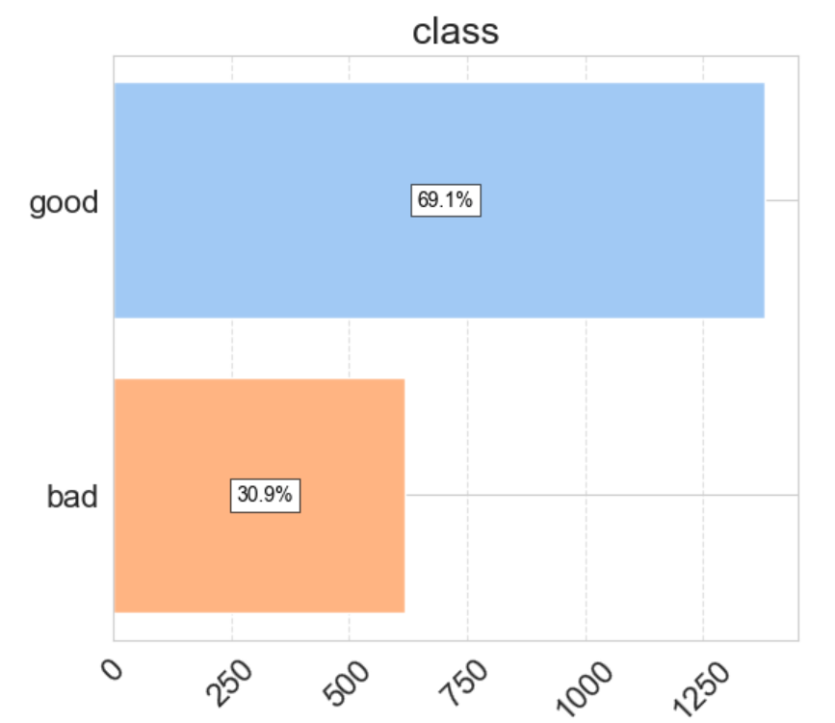
DATA EXPLORATION
Target variable distribution
2000 observations, 30 features + target
Target (Class) - Good=69.1% (1382 ) / Bad=30.9% (618)
Continuous varaibles - 13 / Categorical varaibles - 17 / Binary target - 1
No missing values in the data
No duplicated values in the data
Correlated/Associated Variables with the Target (Spearman, Chi2 Test)
Varied Distributional Characteristics

Slide 13
DATA PREPARATION
01
Exploratory Data Analysis
eda using pandas profiling and additonal plots
visualizations of transformations (e.g. log)
correlation plots & binning
02
Data Processing
Mapping categorical variables
Categorical variables encoded using One Hot Encoding
Varaibles scaled using StandardScaler and MinMaxScaler accordingly
Used train_test_split, where test is 20% of the data (Out of sample data)
Scalers fitted on train split, then transformed both train and test
All results checked with stratified k-fold Cross-Validation

Slide 14
MODELLING APPROACH
We checked a variety of different algorithms using AutoML
and chosen the most promising ones
Random Forest Classifier
XGBoost Classifier
CatBoost Classifier
A foundational model in predictive modeling, the Random Forest Classifier adopts a bagging (Bootstrap Aggregating) ensemble technique. It constructs multiple decision trees, training each on a subset of the dataset through bootstrapping, and subsequently aggregates their predictions. This methodology enhances robustness and interpretability, serving as an invaluable tool for establishing baseline predictive performance.
XGBoost, short for eXtreme Gradient Boosting, is a powerful and efficient gradient boosting algorithm designed for classification and regression tasks. It sequentially builds a series of decision trees, each correcting errors from the previous ones. XGBoost introduces regularization techniques and utilizes gradient information for optimal tree construction, making it highly robust and adaptable to different data distributions. Known for its state-of-the-art performance and minimal hyperparameter tuning requirements, XGBoost is a popular choice in machine learning competitions and real-world applications where accuracy and efficiency are paramount.
CatBoost, short for Categorical Boosting, is a high-performance gradient boosting framework tailored for classification tasks. Designed to handle categorical features seamlessly, CatBoost employs advanced strategies to accelerate model training without compromising accuracy. With its efficient handling of large datasets and built-in support for categorical variables, CatBoost stands out for its speed and effectiveness. The framework incorporates techniques to reduce memory usage and accelerate convergence, making it particularly well-suited for complex classification challenges.
Extra Trees Classifier
Stacking
An ensemble learning method that belongs to the family of decision tree-based models. Similar to Random Forests, Extra Trees builds multiple decision trees during training but with a key distinction — it introduces an additional layer of randomness in the tree-building process. Rather than selecting the optimal split at each node, Extra Trees randomly chooses splits, leading to a higher level of diversity among the individual trees. This technique often results in improved generalization performance and robustness.
As an advanced ensemble technique, stacking combines predictions from diverse models through a meta-model. By strategically incorporating the outputs of multiple base models, stacking enhances predictive performance beyond the capabilities of individual models. This approach mitigates biases and anomalies, contributing to improved accuracy and reliability in classification scenarios.
Voting
The voting ensemble method aggregates predictions from multiple models through a majority decision. This approach is pivotal in alleviating individual model biases and anomalies, fostering a more robust and accurate final prediction in classification tasks.

Slide 15
MODELLING RESULTS
For each model, we searched for the best hyperparameters (Random Search)
and used Forward Selection algorithm with Random Forest to get the final features
Random Forest
XGBoost
CatBoost
Hyperparameters
'n_estimators': 100,
'min_samples_split': 7,
'min_samples_leaf': 4,
'max_features': 'sqrt',
'max_depth': 8
Results
AUC PR: 0.76
Balanced Accuracy: 0.71
Gini: 0.73
Hyperparameters
'subsample': 0.7,
'n_estimators': 300,
'max_depth': 9,
'learning_rate': 0.07,
'colsample_bytree': 0.4,
colsample_bylevel = 0.4
Results
AUC PR: 0.85
Balanced Accuracy: 0.83
Gini: 0.83
Hyperparameters
{'subsample': 0.7,
'learning_rate': 0.09,
'iterations': 450,
'depth': 6,
'colsample_bylevel': 0.8,
Results
AUC PR: 0.83
Balanced Accuracy: 0.79
Gini: 0.79
Extra Trees
Stacking
Voting
Hyperparameters
'n_estimators': 200,
'min_samples_split': 8,
'min_samples_leaf': 2,
'max_depth': 8,
Results
AUC PR: 0.85
Balanced Accuracy: 0.76
Gini: 0.85
Hyperparameters
'weights': None,
'voting': 'soft',
'flatten_transform': False,
Results
AUC PR: 0.8
Balanced Accuracy: 0.76
Gini: 0.76
Hyperparameters
'penalty': 'l2',
'C': 10,
Results
AUC PR: 0.91
Balanced Accuracy: 0.87
Gini: 0.9

Slide 16
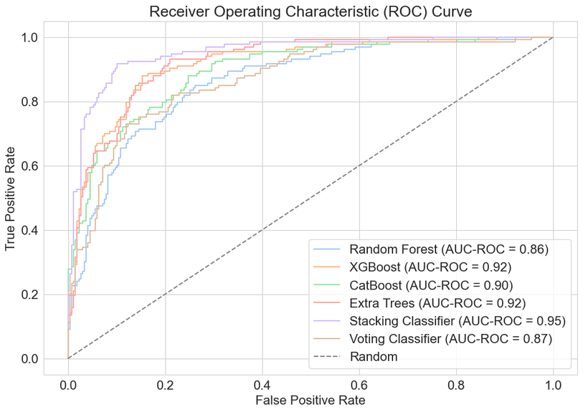
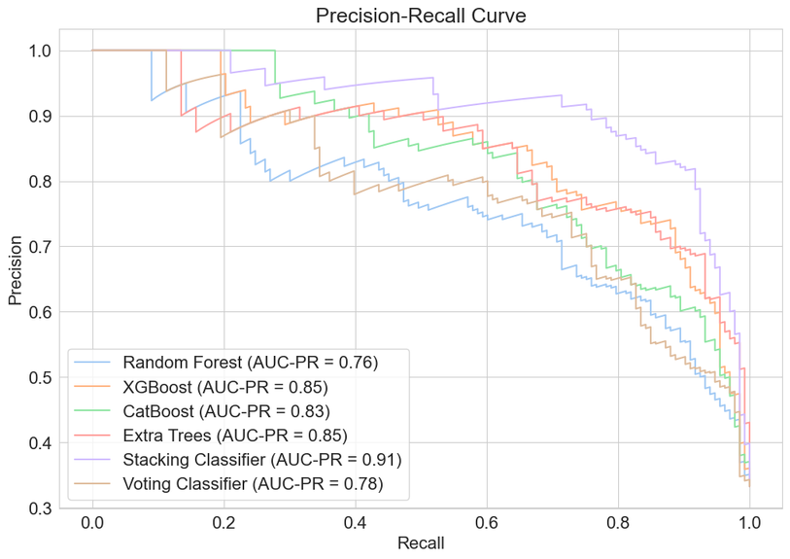
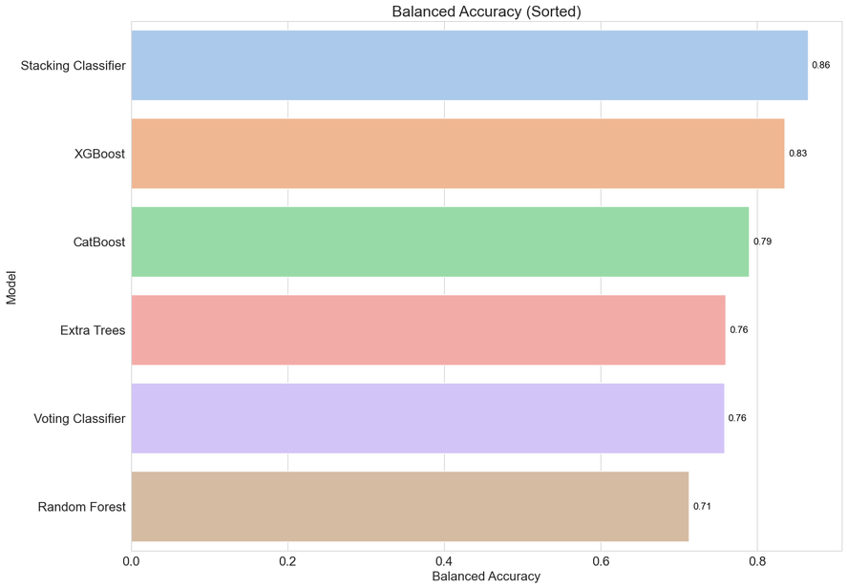
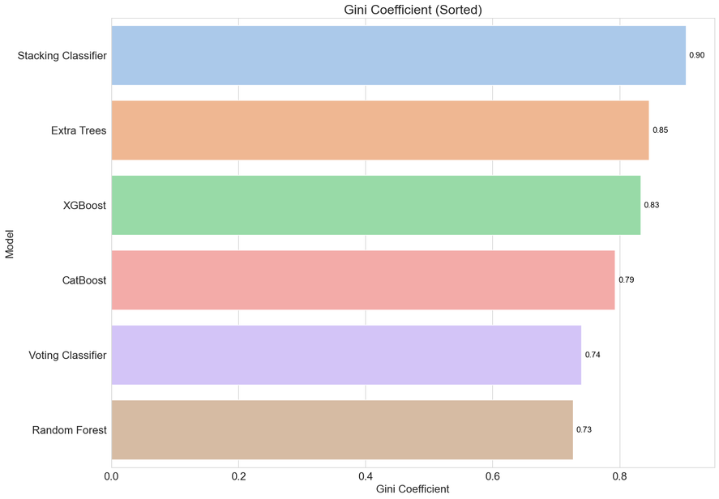
MODELLING RESULTS

Slide 17
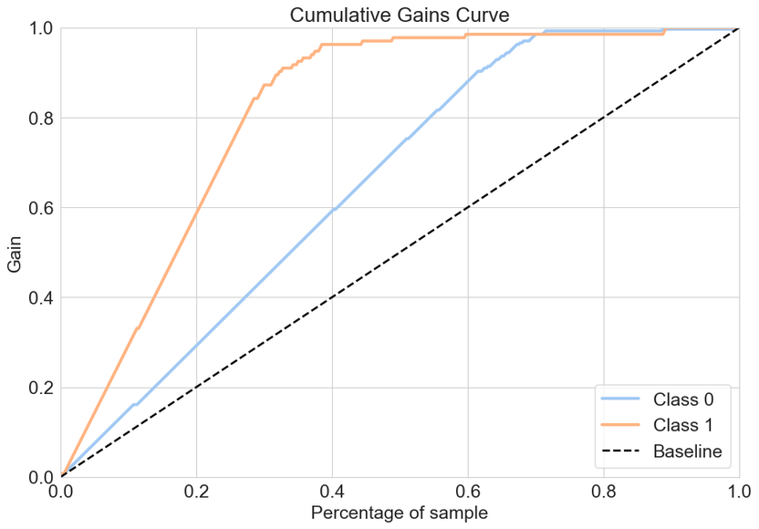
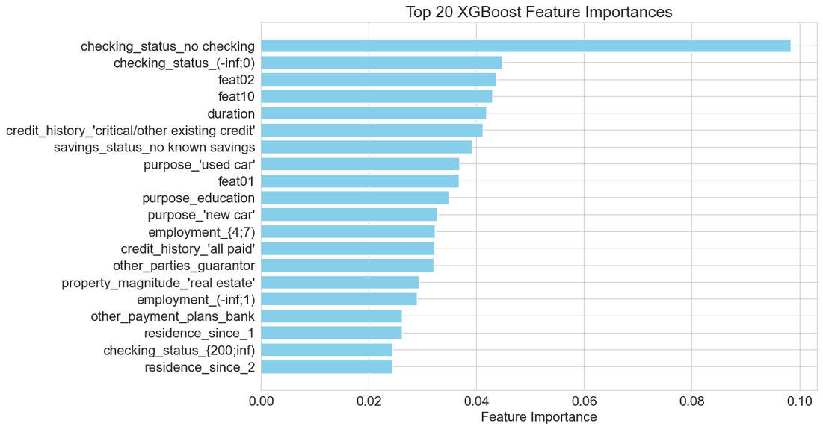
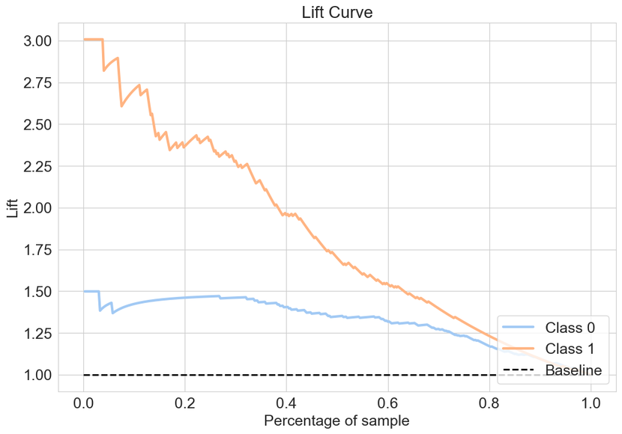
DEEP DIVE - XGBOOST
scale_pos_weight - adressing imbalance classes in target variable
eval_metric='aucpr' - better for imbalance target
Hyperparameters
'subsample': 0.8,
'n_estimators': 250,
'max_depth': 8,
'learning_rate': 0.09,
'colsample_bytree': 0.7,
'colsample_bylevel': 0.9.
Results
AUC PR: 0.94
Balanced Accuracy: 0.93
Gini: 0.94

Slide 18
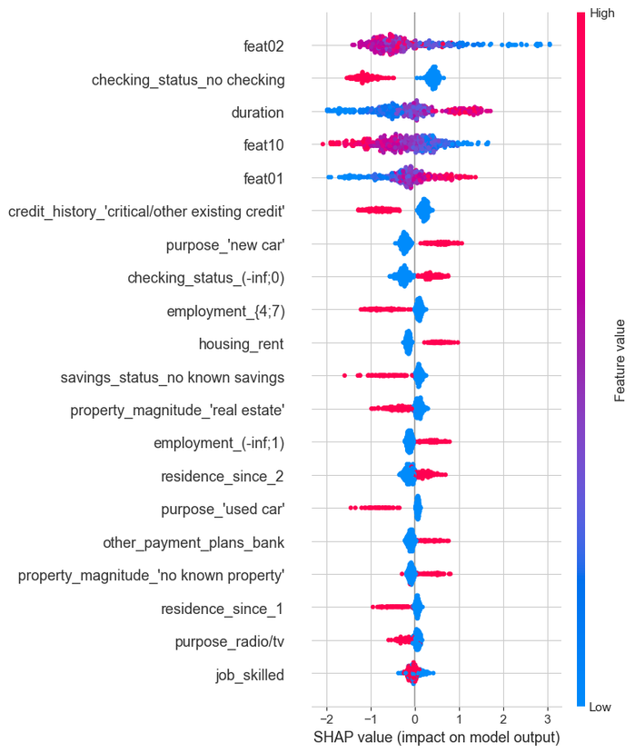
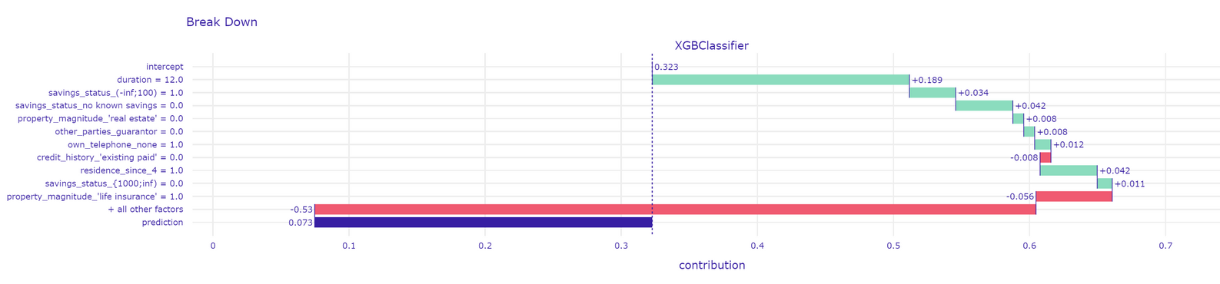
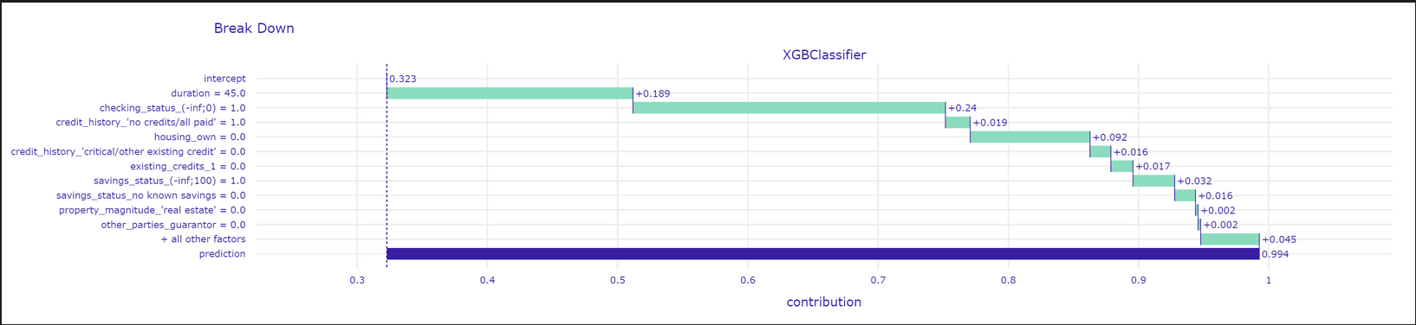
EXPLAINABLE AI

Slide 19

FUTURE ENDEAVORS
IN MODEL DEVELOPMENT
REGRESSION
Choose better hyperparamerets to combat overfitting and generalize the models
Try to improve the Linear Regression model to find which interactions are beneficial
Transform the output variable (log etc.) to get better results
CLASSIFICATION
Explore the integration of Synthetic Minority Over-sampling Technique (SMOTE) to address class imbalance
Mitigating Overfitting with Regularization Techniques
Exploration of other Hyperparameter Optimization Techniques - Grid Search / Bayesian Optimization

Slide 20

Thank you for attention
Any questions?

